Slide 1

Hospital Management System
This project was designed to simplify hospital operations and make the management of patients, staff, and resources more efficient.
BY GROUP 8

Slide 2


System Overview
Java Swing
Provides a seamless user interface for easy navigation and interaction.
JDBC
Enables powerful database connectivity for real-time data management.

Slide 3


SCOPE: LOGIN PAGE
landing page dashboard for patients
Hospital staff login
patient management admin
1.consultation
ambulance management admin
2.admission process
doctor management admin
3.insurance and TPA
Laboratory Management
4.short stay service
medicine management
staff management
5.e Brochure
6.hospital Tour

Slide 4

UI For Patient
Consultation and Search Doctors
Easily search for and connect with your assigned doctors using the consultation search feature. Authorized users can quickly locate their respective doctors by name, department, or specialty, ensuring seamless access to consultation details and medical guidance.
Short Stay Service
Our Short Stay Service provides a comprehensive experience for brief medical visits, including essential admission information, post-admission care, surgical patient details, medical patient records, and chemotherapy information. This streamlined service ensures prompt attention and efficient care while minimizing wait times, all in a comfortable setting.
Insurance and TPA
Stay informed with our Insurance and Third-Party Administrator (TPA) information service. This feature provides patients and authorized users with essential details about insurance coverage, claims processes, and TPA contacts. It ensures that patients have easy access to the necessary information for seamless insurance coordination, making the financial aspect of their healthcare experience hassle-free.

Slide 5
Admission Process
Our Hospital Admission Details service offers a comprehensive overview of the admission process. It includes essential information on required documents, payment options, and pre-admission protocols. Patients and authorized users can easily access step-by-step guidelines to ensure a smooth and efficient admission experience, allowing for timely care and support from the moment they arrive.
E - Brochure
Discover our e-Brochure, designed to provide patients and visitors with a comprehensive overview of our hospital's services, facilities, and admission procedures. This digital resource includes essential information about medical specialties, treatment options, insurance details, and patient support services.
Hospital Tour
Join us for a guided Hospital Tour, where you can explore our state-of-the-art facilities and learn about the services we offer. This immersive experience provides insight into our patient care areas, treatment technologies, and support services. Whether you’re a prospective patient, a family member, or a healthcare professional, the tour offers a valuable opportunity to understand our commitment to quality care and patient comfort.

Slide 6


Scope Patient Managment
Add and search Patient
Authorized users can efficiently add new patient profiles, capturing key details like name, age, medical history, and contact information with accuracy. This ensures that all patient data is securely stored for easy future reference and improved care management. The system also features a powerful search function, enabling users to quickly find patient records by searching through Ds, or other filters, providing instant access to vital information such as medical history, contact details, and current treatments.
Delete Patient Information
Authorized users have the ability to securely delete patient information from the system. This feature ensures that outdated or irrelevant patient data is removed, maintaining the integrity and accuracy of the database while complying with privacy and data management standards.
Save and Update
Authorized users can effortlessly update and manage patient information, ensuring the database stays accurate and current with the latest details. This feature guarantees seamless access to up-to-date patient records for better care and management.

Slide 7
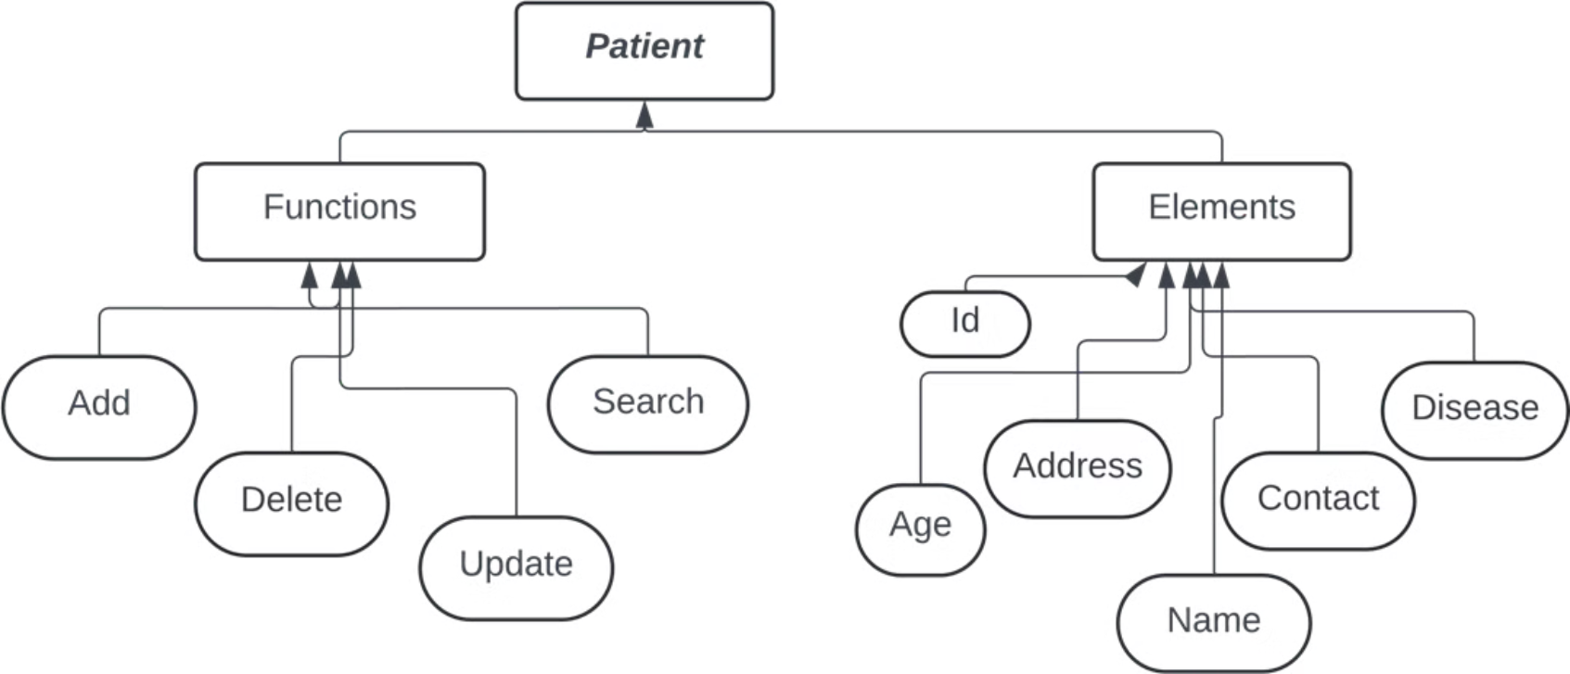

Slide 8


Scope: Doctor Management
1
Comprehensive Doctor Profile
Doctors can easily access and manage their personal information, including a detailed overview of their patient load, appointment schedule, and research contributions.
2
Efficient Appointment Management
The dynamic calendar ensures seamless appointment scheduling and editing, streamlining the doctor's workflow.
3
Robust Research Platform
The integrated research module provides a user-friendly interface for adding, updating, deleting, and searching for research articles, fostering a collaborative research environment.

Slide 9
Scope: Staff Management
Edit Staff Information
Delete Staff Records
Save and Update
The system allows authorized users to modify existing staff details, ensuring that the database reflects accurate and updated information.
Administrators can safely remove staff records from the database, maintaining a clean and organized staff roster.
All changes to staff data are securely saved in the MySQL database, ensuring data integrity and easy retrieval for future use.

Slide 10
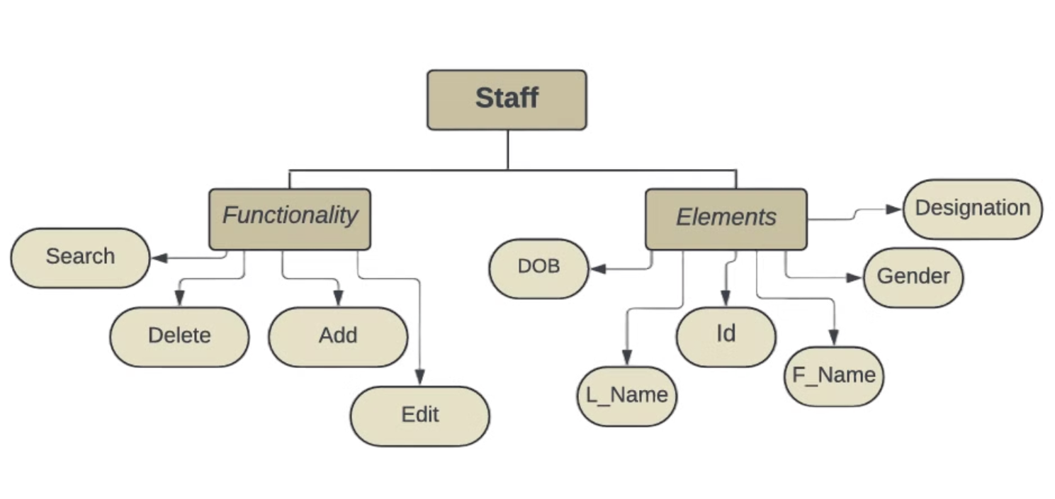
ER Diagram of Staff management

Slide 11





Scope: Pharmacy
Simple Medicine Management
Easily add, update, or remove medicines from the system, keeping records of important details like expiry dates and available stock.
Real-Time Stock Monitoring with Alerts
The system tracks medicine levels in real time and automatically triggers alerts when stock falls below a set limit, ensuring timely restocking.
Instant and Secure Database Updates
All changes to medicine records are securely saved and instantly reflected in the database, ensuring accurate and accessible information.

Slide 12

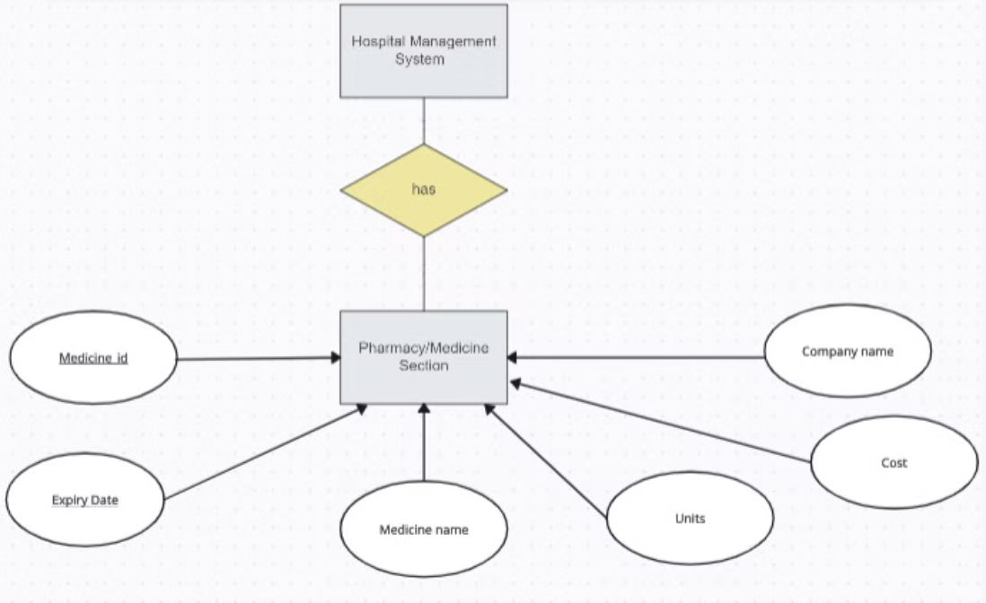

Slide 13

Laboratory Management
System Overview:
A Java Swing application for managing laboratory resources like reagents, biological samples, equipment, and consumables with CRUD operations.
Features:
Reagents: Add, update, delete, and view details like stock, batch, and expiry.
Biological Samples: Manage sample collection, status, and patient ID.
Equipment: Track equipment details, maintenance, and status.
Consumables: Manage stock, supplier info, and reorder levels.
Data Management:
Use a database (MySQL) for storing data and ensure CRUD operations reflect in real-time.

Slide 14

Additional Features:
Search & Filter: Quickly find specific data within categories.
Data Validation: Ensure input accuracy.
Reports (Optional): Generate usage and stock reports.
Future Scope:
Expand to integrate with hospital systems, add automation (e.g., low stock alerts), and support cloud storage.

Slide 15

Ambulance Management
The Ambulance Management System is designed to efficiently manage ambulance services, ensuring timely dispatch and smooth operation. The system allows administrators to manage data related to ambulances and track dispatch operations effectively.
Key Features:
Data Management
Ambulance Dispatch
Data Visualization(still work in progress)

Slide 16
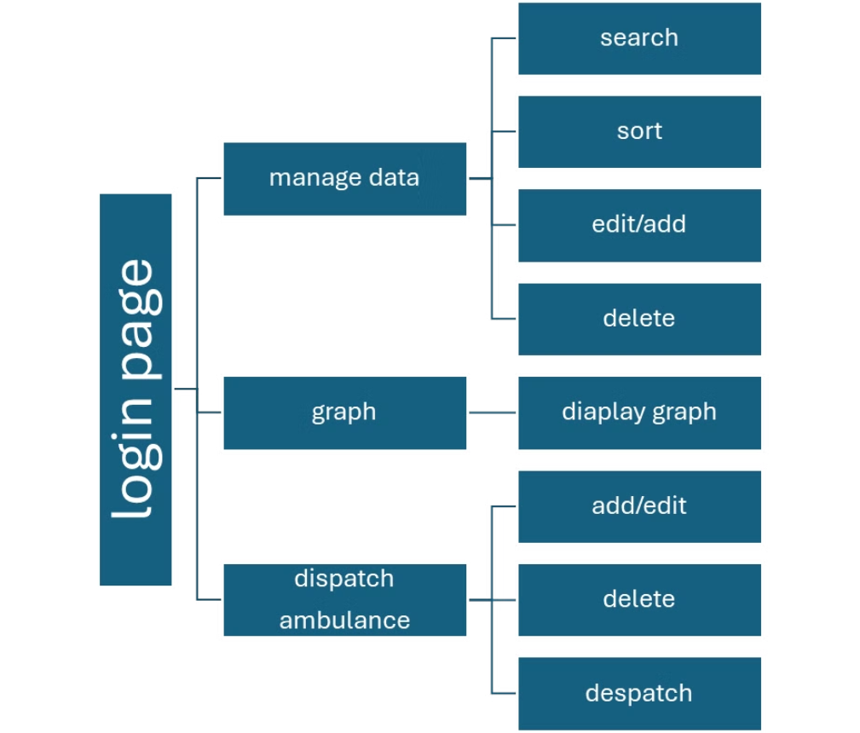

Slide 17




flow of Ambulance Management
Username and Password Authentication
Search: Locate specific ambulance data.
Add/Edit/Delete: Manage dispatch records.
Operational Statistics and graph
Secure Access for Admins and Dispatch Operators
Sort: Organize data
DFS Traversal: The DFS algorithm is used to explore the graph, visiting each connected node.
Add/Edit: Update ambulance records or add new ones.
Dispatch: Send ambulances to emergency locations.
Delete: Remove outdated or incorrect entries.
Graph Print: The graph is displayed with nodes and their connections to visualize the structure.

Slide 18


Conclusion
By integrating features like staff, patient, doctor management, and a pharmacy, the system optimizes workflow, enhances patient care, and reduces manual errors. The database-driven backend ensures secure, real-time data storage and retrieval, while the user-friendly interface simplifies complex tasks for hospital administrators. The hospital management system provides an efficient and scalable solution for managing the essential aspects of hospital operations.

